Slide 1
Massive feature creation
Start
Model training
Create a descending order of features based on total gain
Create an average feature importance ranking
Create a descending order of features based on total cover
Add one feature starting from the highest ranking
New hyperparameters set
Model training
Fold 1
Fold 2
Fold 3
Fold 4
Fold 5
No
TSCV error
All HPO iterations performed?
All features added or tolerance reached?
Yes
No
Keep the features with the lowest TSCV error
Yes
Keep the hyperparameters and the features with the lowest TSCV error
End

Slide 2
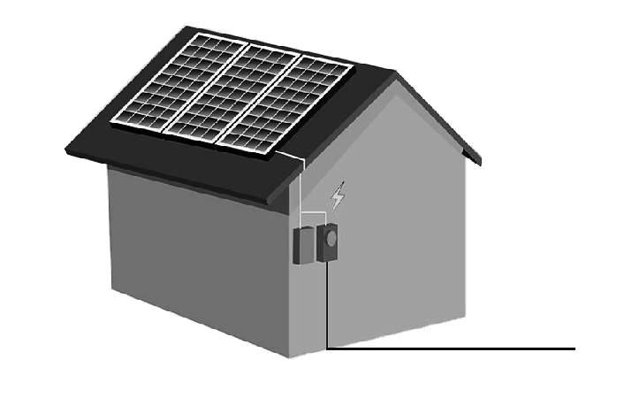
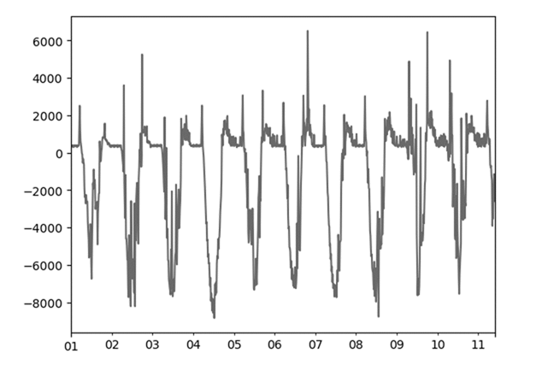

Inputs
Time series
Modelling
Feature Engineering
Model Selection
Net Load Data
Target
HPO
Weather &
ML-derived Information
Sliding Window
Evaluation
Weather Data
Features

